Slide 1
Monetary Policy and the Distribution of Wealth and Income: A Deep Learning Approach
Research Question
What are the distributional effects of monetary policy on household wealth and income in finite horizon setting?
Method
I propose using deep reinforcement learning (DRL) to solve a complex household optimization problem. DRL is well-suited for solving problems with high dimensionality and complexity, solving the curse of dimensionality. It also allows for heterogenous actions within a simulated environment, reflecting real choices of a household.
Motivation
This thesis studies how monetary policy affects the distribution of household wealth and income. By solving a rich finite-horizon household model with DRL methods, it advances both our understanding of monetary transmission channels and demonstrates how DRL can tackle high-dimensional economic problems.

Slide 2
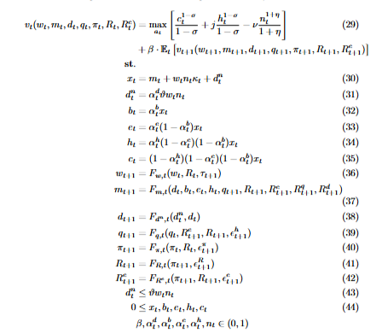
The Bellman Equation

Slide 3
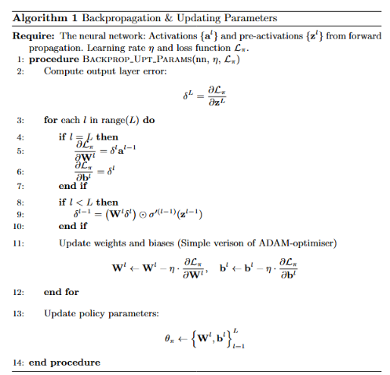
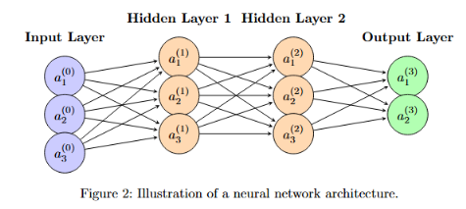
Algorithms: Backpropagation Updating Network Parameters

Slide 4
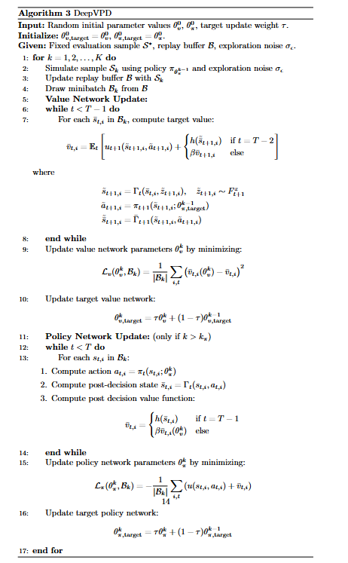
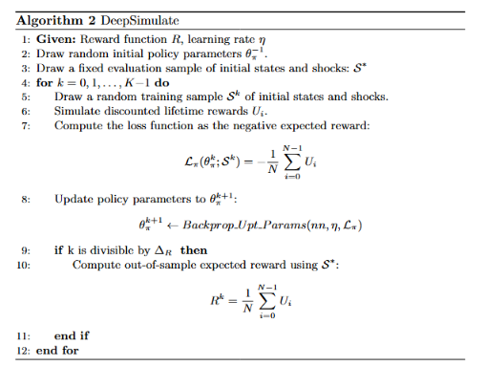
Algorithms: DeepSimulate & DeepVPD

Slide 5
Results

Slide 6
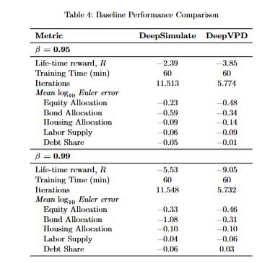
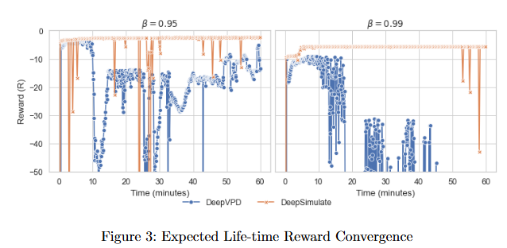
Performance - Impatient vs. Patient Households

Slide 7
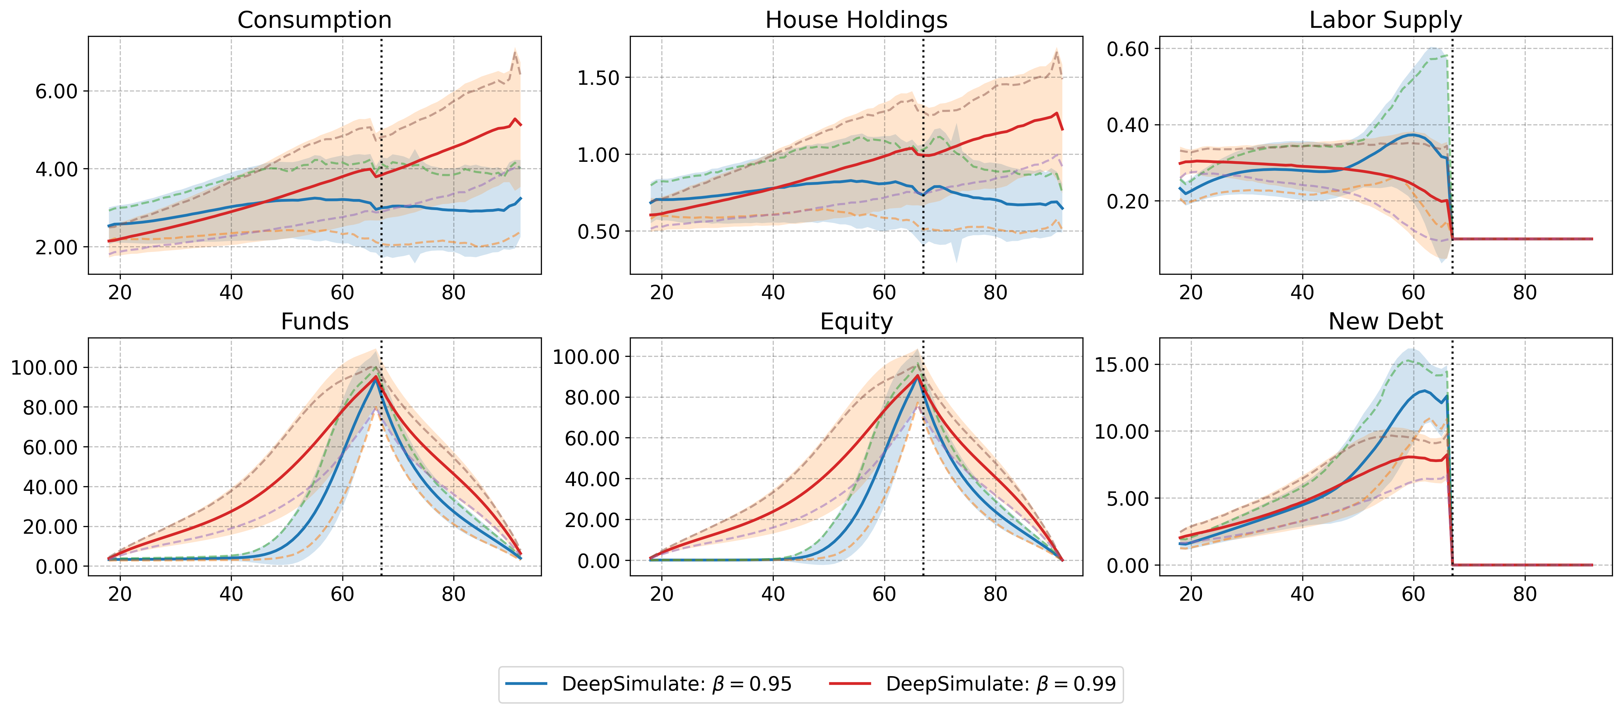
Outcomes - Impatient vs. Patient Households

Slide 8
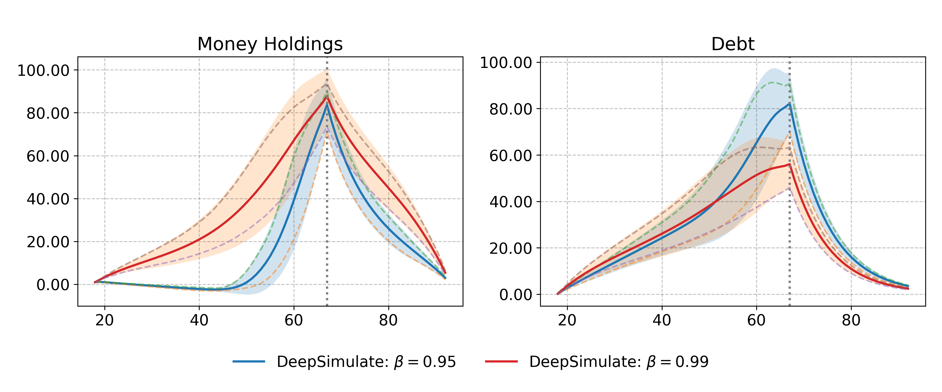
States - Impatient vs. Patient Households

Slide 9
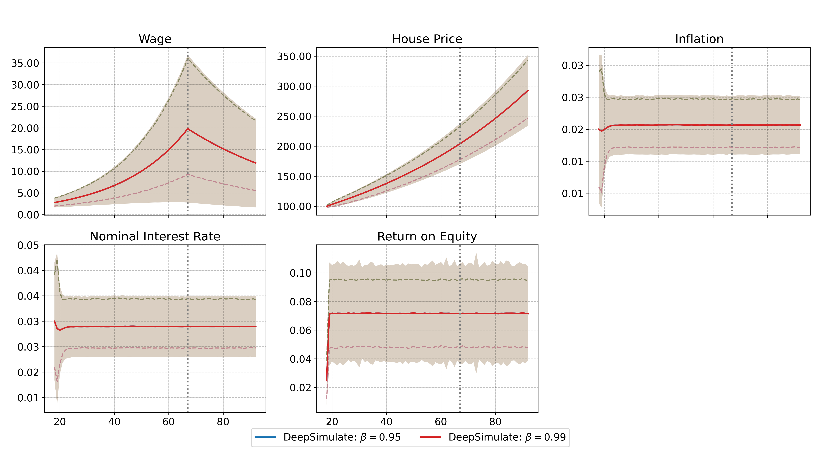
States - Impatient vs. Patient Households

Slide 10
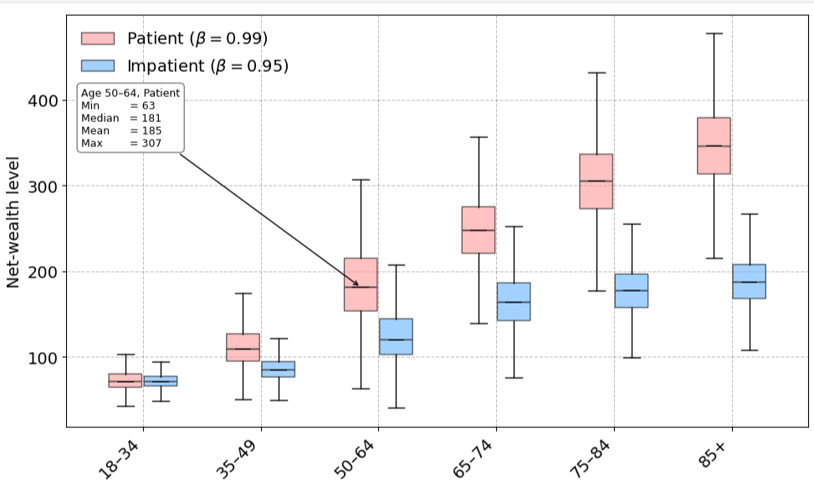
Wealth Distribution - Impatient vs. Patient Households

Slide 11
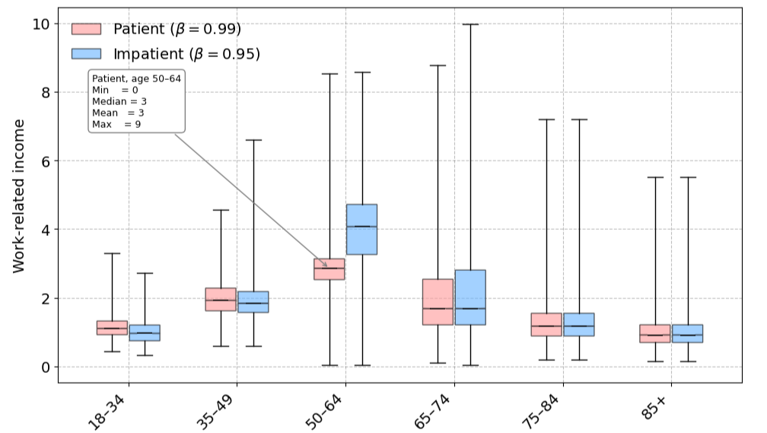
Income Distribution - Impatient vs. Patient Households

Slide 12
Results - Extending
Heterogenous Agents

Slide 13
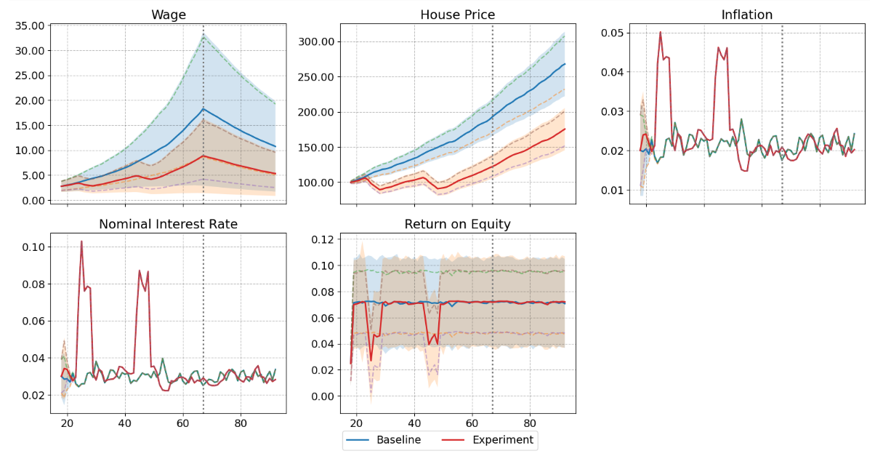
Expanding & Experimenting – States

Slide 14
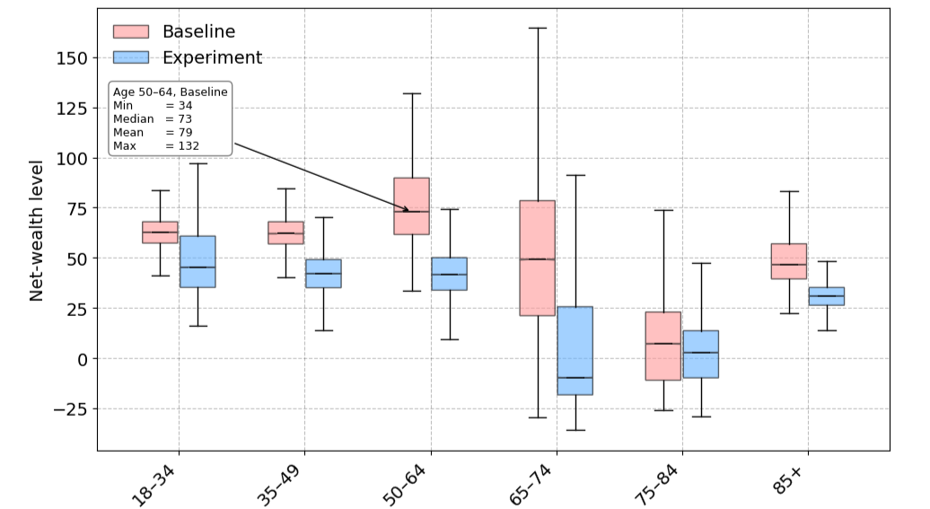
Expanding & Experimenting – Distributional Impact on Wealth

Slide 15
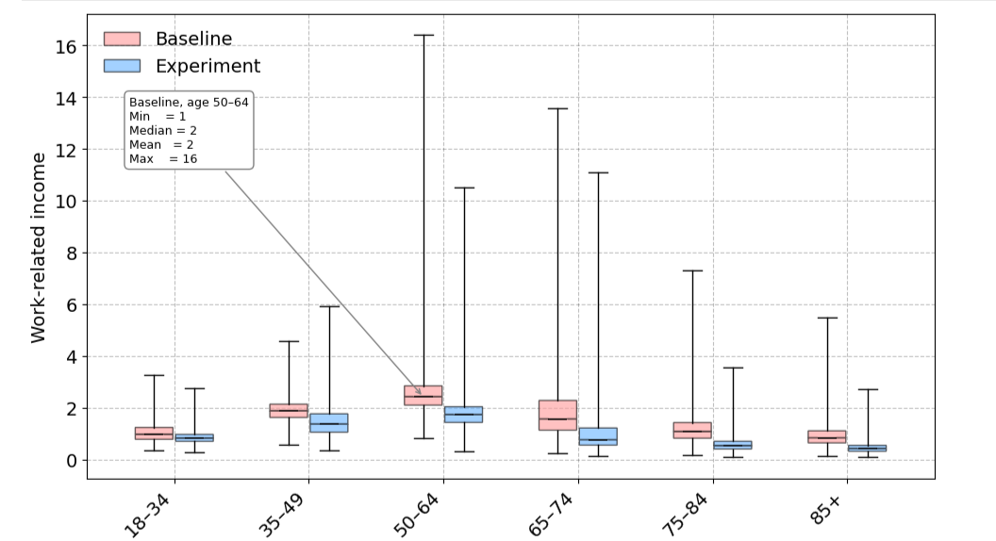
Expanding & Experimenting – Distributional Impact on Income

Slide 16
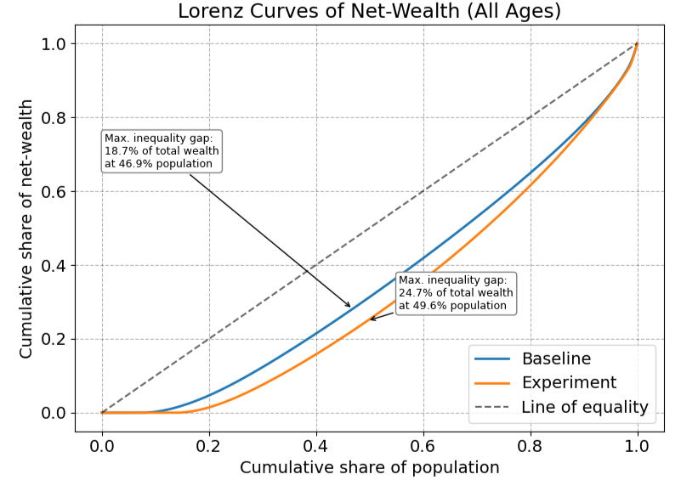
Expanding & Experimenting – Wealth Inequality

Slide 17
Appendix

Slide 18

Deep Reinforcement Learning (DRL): A simple case

Slide 19
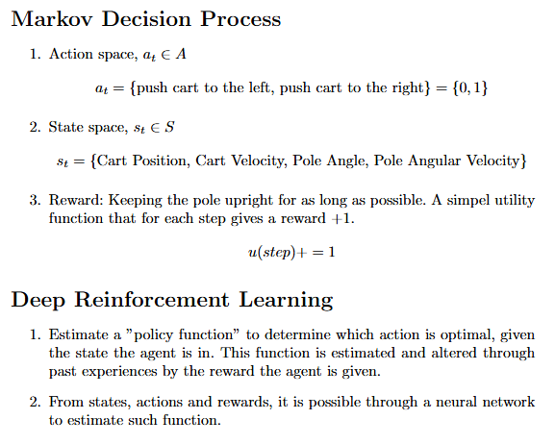
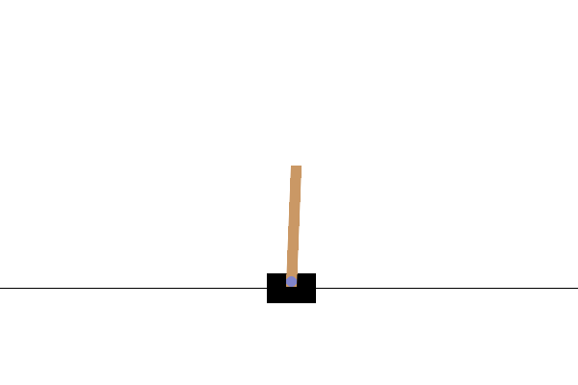
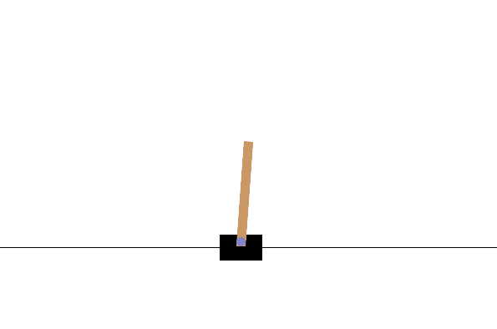
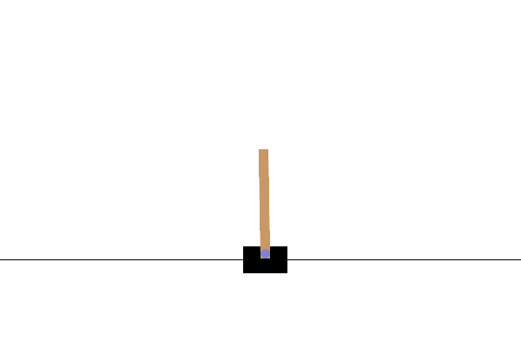
Deep Reinforcement Learning (DRL): A simple case

Slide 20
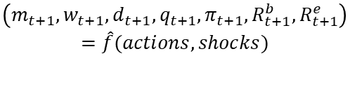
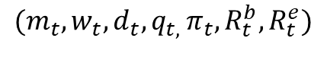
Connecting DRL to Economics (and the RQ)
Agent = Household
Policy by Neural Network: Consume, labour hours, debt, investments Estimated by ANN
Agent decide actions
Agent Observes state
Policy update
Reinforcement Learning
Action:
Consumption
Labour hours
Obtain debt
Allocate resources to investments (bonds, equities and housing)
States:
$$(m_{t}, w_{t},d_{t}, q_{t, }π_{t},R_{t}^{b},R_{t}^{e})$$
Reward: Based on consumption, house holdings and disutility from labour hours
Environment Actions and Shocks
$$\left(m_{t+1},w_{t+1},d_{t+1},q_{t+1},π_{t+1},R_{t+1}^{b},R_{t+1}^{e}\right)=\hat{f}(actions, shocks)$$
Agent recieves reward from actions

